Slide 1




Basketball I
Produced by Dr. Mario
UNC STOR 390

Slide 2

Overview of Basketball

Slide 3
Basketball Statistics
Information Tracked in Box Score
Two-Point Field Goals
Three- Point Field Goals
Free Throws
Personal Fouls
Assists
Offensive/Defensive Rebounds
Blocked Shots
Turnovers
Steals
Minutes Played

Slide 4



Basketball Statistics
Classic Measures of Field Goal Percentage
Effective Field Goal Percentage (EFG)
Problem with Previous Metrics
Knicks: 15/20 Field Goals = 30 Points
Lakers: 15/20 3-Pt Field Goals = 45 Points
Same Field Goal Percentage (75%)
New Metric
Adjusted EFG%
Knicks: 75%
Lakers: 1125%
FGM = Field Goal Made
FGA = Field Goal Attempt
3FGM = 3-Pointer Made
3FGA = 3-Pointer Attempt
$$FG\%=\frac{FGM}{FGA}$$
$$3FG\%=\frac{3FGM}{3FGA}$$
$$EFG\%=\frac{FGM+0.5×3FGM}{FGA}$$

Slide 5


Basketball Statistics
Rebounding
Raw Rebounds is Misleading
Percentage of Rebounds When on Offense (OREB%)
Percentage of Rebounds When on Defense (DREB%)
REB = Rebound
OREB = Offensive Rebound
DREB = Defensive Rebound
FGA = Field Goal Attempt
FTM = Free Throw Made
FTA = Free Throw Attempt
$$OREB\%=\frac{OREB}{Missed FGA}$$
$$DREB\%=\frac{DREB}{Opponent Missed FGA}$$

Slide 6


Basketball Statistics
Free Throws
Classic Free Throw Percentage (FT%)
Free Throw Rate (FTR)
Interpretation: Suppose FTR = 0.39. For Every 100 Shots, the Team is Getting Around 37 Free Throws
FGA = Field Goal Attempt
FTM = Free Throw Made
FTA = Free Throw Attempt
$$FT\%=\frac{FTM}{FTA}$$
$$FTR=\frac{FTA}{FGA}$$

Slide 7


Basketball Statistics
Turnovers
Possession
Starts When Team Gets Ball
Ends When Shot Hits Rim or Opponent Gets Ball
Average Possessions Per Game Between 90 and 95
Turnover Defined
Occurs When Team Loses Possession Before Attempting Shot
Offense Commits Turnovers and Defense Causes Turnovers
Offensive Turnovers Per Possession (TO%)
Defensive Turnovers Per Possession (DTO%)
TO = Turnover
$$TO\%=\frac{TO Committed}{Offensive Possessions}$$
$$DTO\%=\frac{TO Caused}{Defensive Possessions}$$

Slide 8
Basketball Statistics
Four Factors For Team Offense
EFG%
OREB%
FTR
TO%
Four Factors For Team Defense
Opponent’s EFG%
DREB%
Opponent’s FTR
DTO%
Four Factors Credited to Dean Oliver (Denver Nuggets)

Slide 9
Basketball Statistics
Four Factors are Uncorrelated
All Giving Unique Information
Highest Correlation
Opponent’s EFG% and DREB% (-0.67)
EFG% and OREB% (-0.47)
OREB% and TO%
Importance of 4 Factors in Regression
Regression on W
Eight Covariates
W = Win
$$W=β_{0}+β_{1}X_{1}+β_{2}X_{2}+⋯+β_{8}X_{8}+ε$$
$$X_{5}=Opponent^{′}s EFG\%$$
$$X_{1}=EFG\%$$
$$X_{6}=DTO\%$$
$$X_{2}=TO\%$$
$$X_{7}=DREB\%$$
$$X_{3}=OREB\%$$
$$X_{8}=Opponent^{′}s FTR$$
$$X_{4}=FTR$$

Slide 10
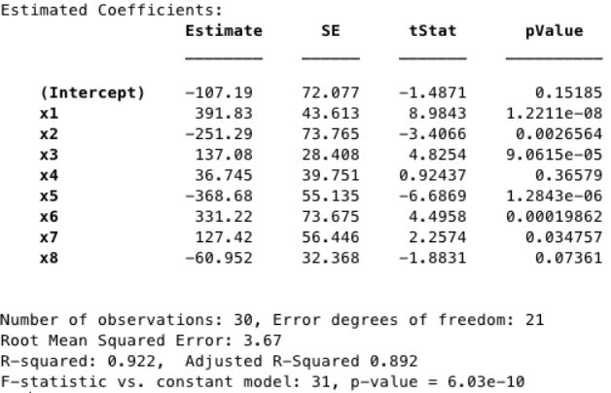
Basketball Statistics
Regression Results from Justin Jacobs (Squared2020.com)
FTR
Opponent’s FTR

Slide 11
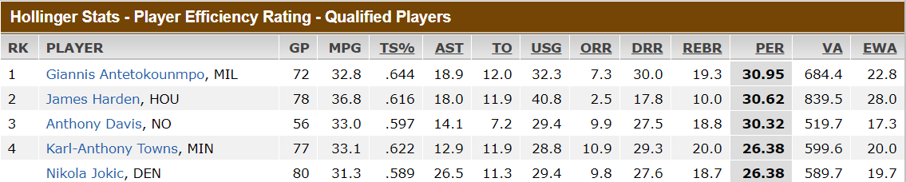
Linear Weights in Basketball
NBA Efficiency Rating (EFF)
Equally Weights Good and Bad Stats
Formula
Player Efficiency Rating (PER)
Created by John Hollinger (VP of Operations for Memphis)
Average Across All NBA Players is 15
PTS =Point
REB = Rebound
AST = Assist
STL = Steal
TO = Turnover
FG = Field Goal
FT = Free Throw
G = Game
$$EFF=[PTS+REB+AST+STL$$
l $−TO−\left(Missed FG\right)−(Missed FT)]/G$

Slide 12
Linear Weights in Basketball
Player Efficiency Rating (PER)
Significant Problems With PER
Bad Weights
Players With Poor Shooting Percentages Can Increase PER by Attempting More Shots
Rewards Bad Shooters
David Berri
Publishes Research Regarding Sports Economics
Wages of Wins Journal
Critical About John Hollinger’s PER

Slide 13

Linear Weights in Basketball
Win Scores (WS)
Formula
To Raise WS by Shooting More, Player Needs to Shoot Above 50% for 2-Pointers or Above 33.3% for 3-Pointers
Wins Produced (WP)
Formula for WP Based on WS
Sum of WP for All Teams Players ≈ Teams Wins
Cannot Conclude WP Represents Individual Wins
WP is Not Good for the NBA’s Top Defenders
PTS =Point
REB = Rebound
AST = Assist
STL = Steal
TO = Turnover
BLK = Block
FGA = Field Goal Attempt
FTA = Free Throw Attempt
PF = Personal Fouls
$$WS=PTS+REB+STL$$
$+ 0.5×AST+0.5×BLK$
$− FGA−TO−0.5×FTA−0.5×PF$

Slide 14
Linear Weights in Basketball
Information Not Tracked in Box Score
Taking Charges
Deflecting a Pass
Box Out
Assisting the Assister
Help Defense
Screens

Slide 15

Final Inspiration
If you can’t dunk, lower the hoop.
- Mahatma Mario

